Slide 1

Reading Workshop
Deputy Head Teacher & English Lead: Mrs M Kitching
September 2026
‘Children who are good at reading do more of it: they learn more, about all sorts of things.’
Research evidence on reading for pleasure ~ DFE

Slide 2
Our Intention
It is our intention, to secure the necessary reading, writing and linguistic skills to become enthusiastic and independent learners. We strive to ensure all our children receive a sequential learning experience, which will equip them with the essential tools to achieve at Widney Junior School and beyond. It is our intention to immerse children in the wonders of quality texts, to ensure all children can read and foster a love for reading, a passion for discovery and the confidence to explore the world.

Slide 3
Overview
How reading is promoted at Widney
Our successes
Your child’s reading journey
How you can support at home

Slide 4
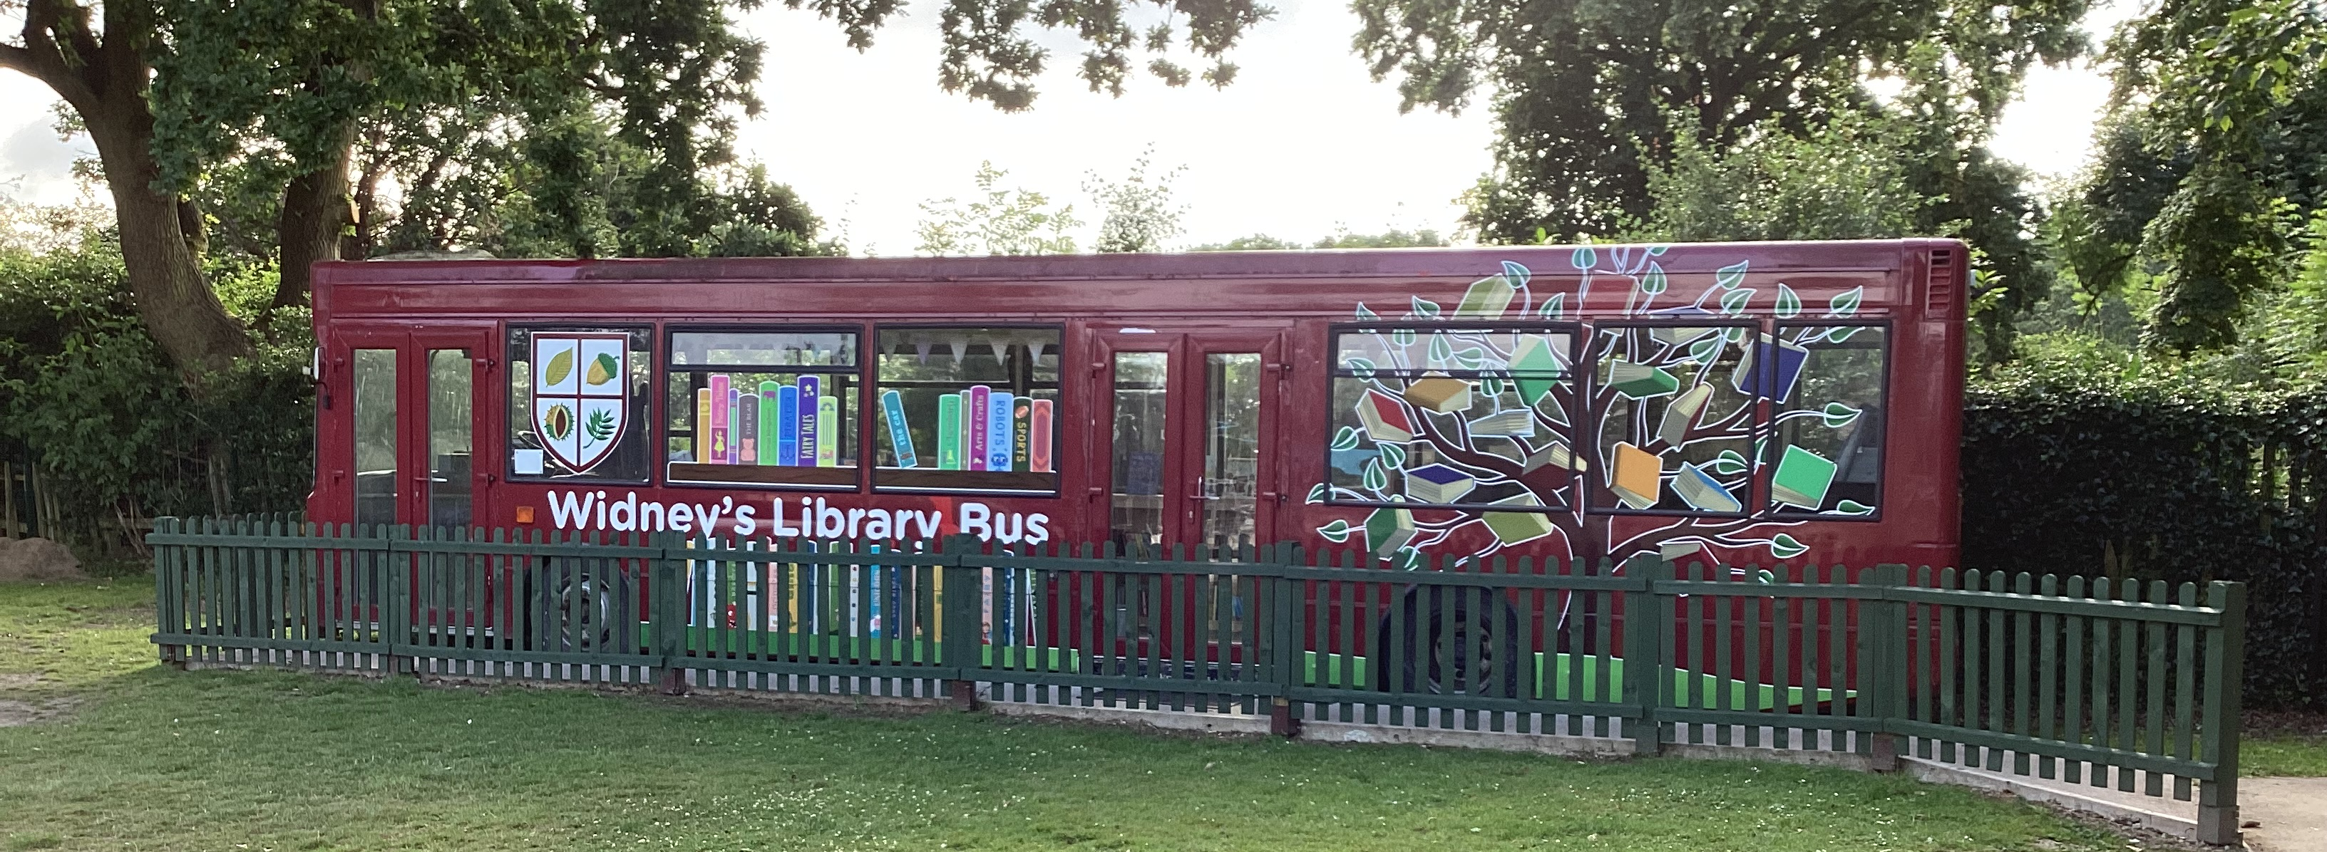
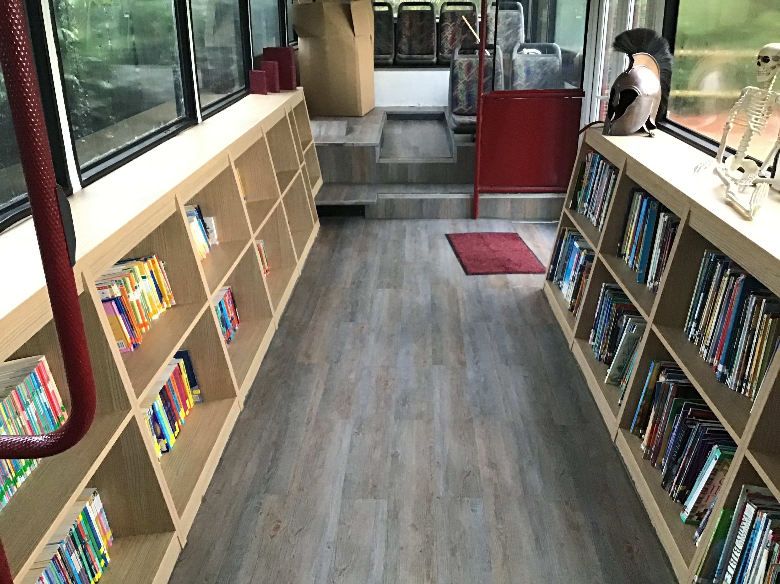
Reading Bus
Notes:
Junior Librarian – children scan books in and out.
Class librarians - responsibilities.

Slide 5
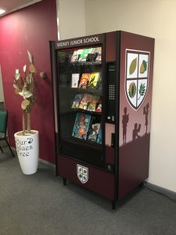
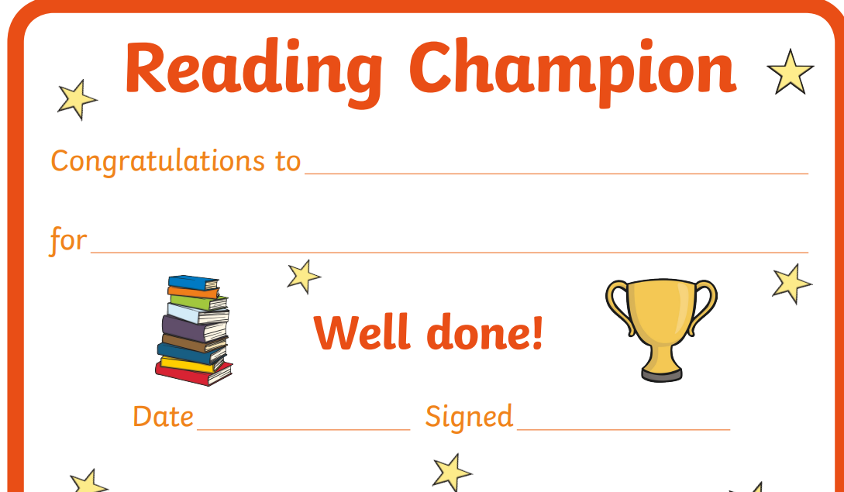
Our Vending Machine

Slide 6
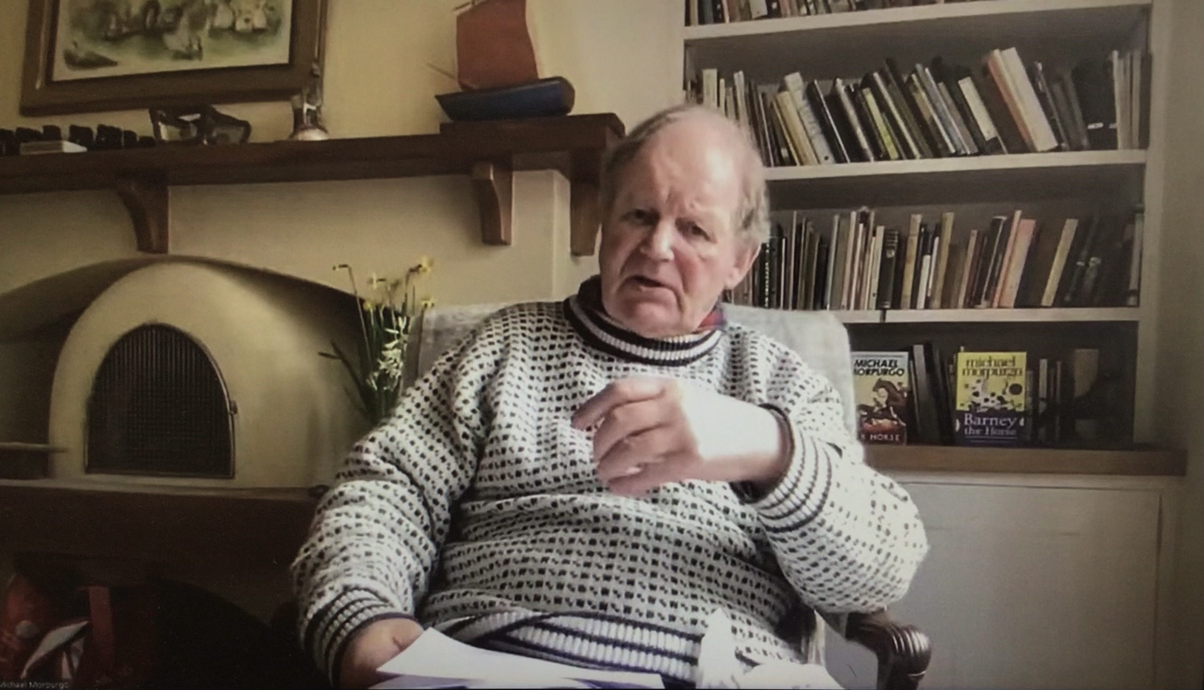
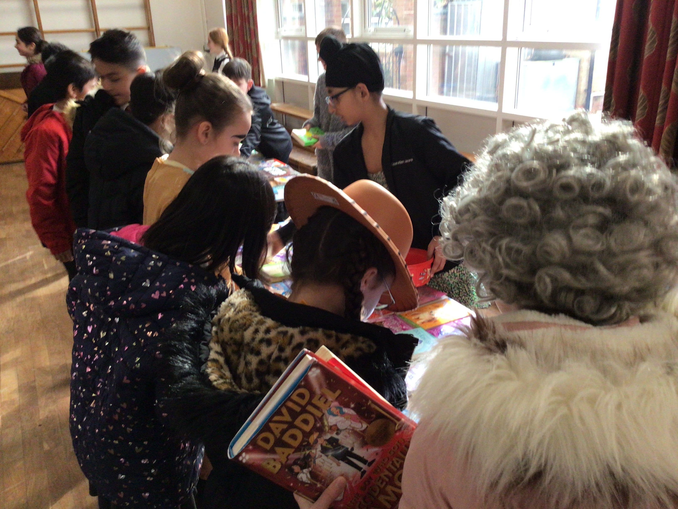
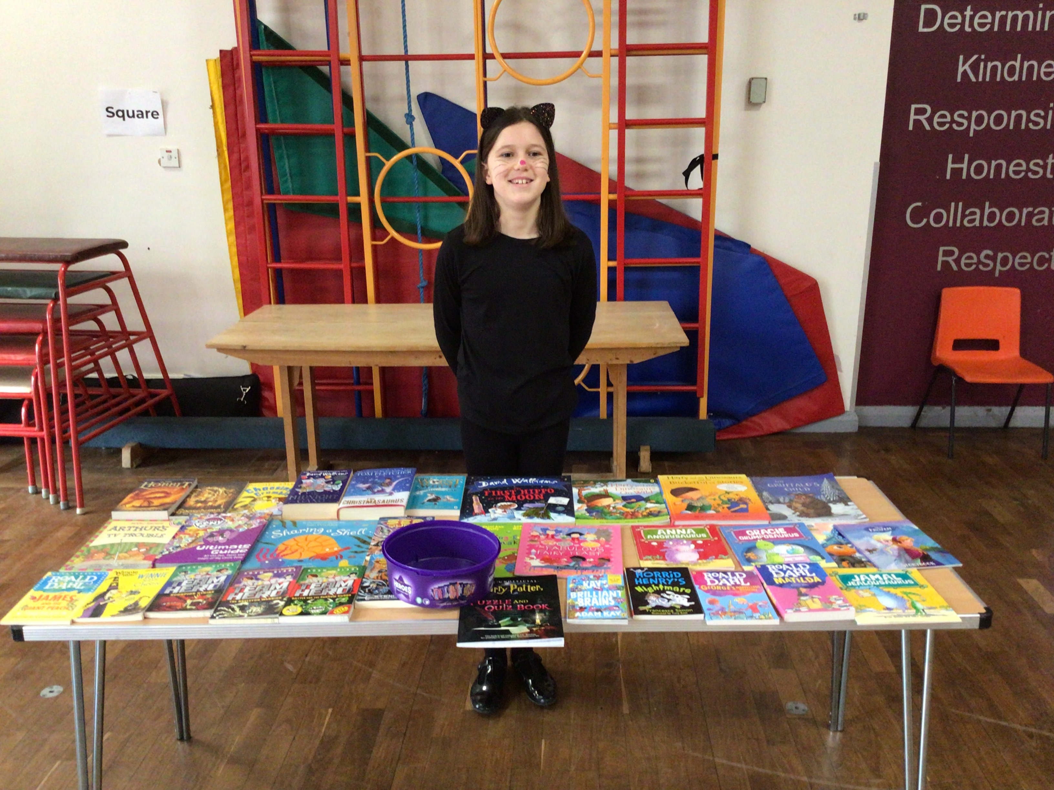
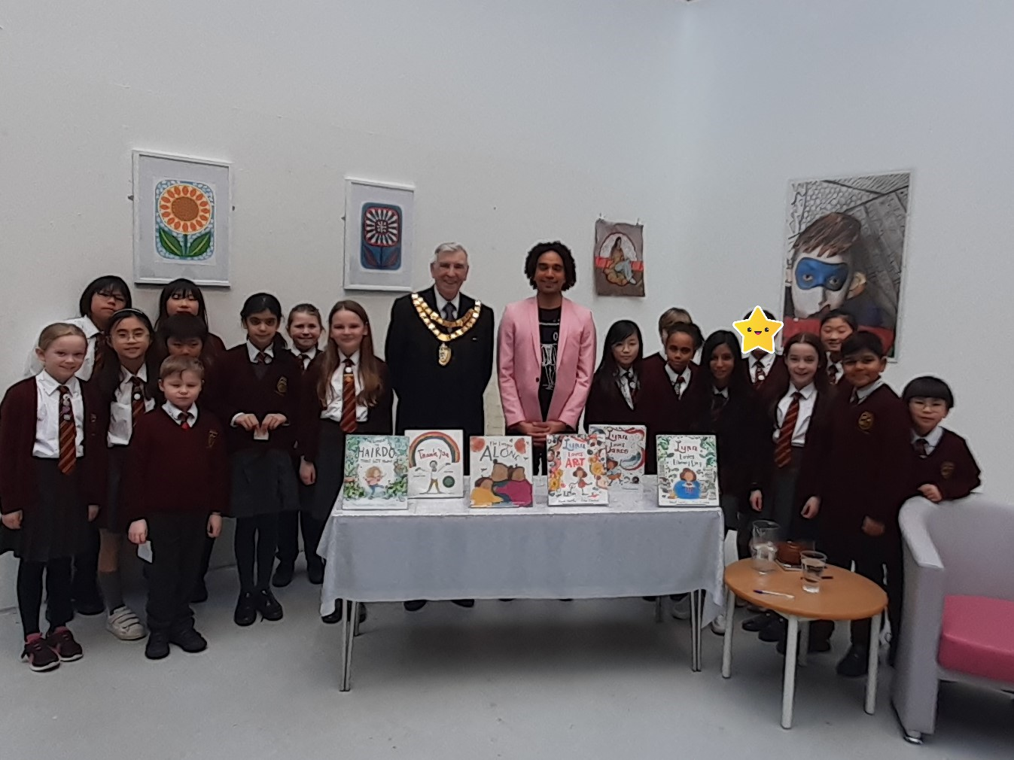
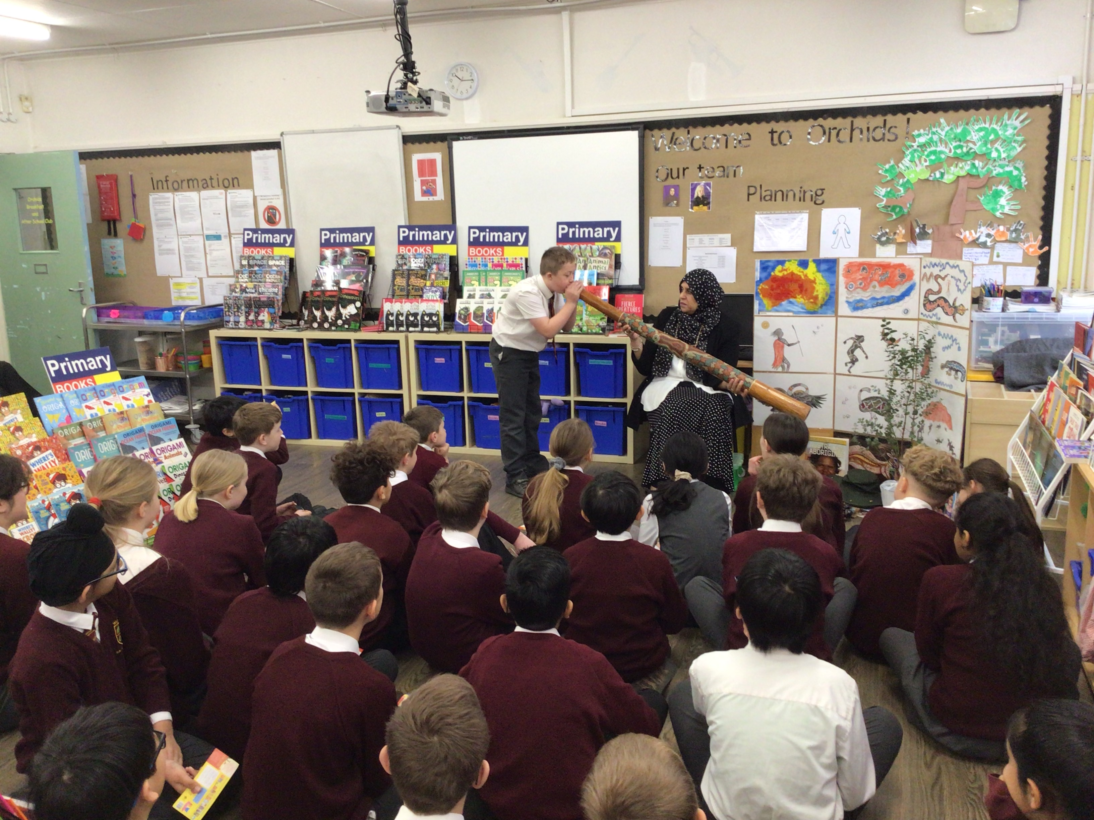
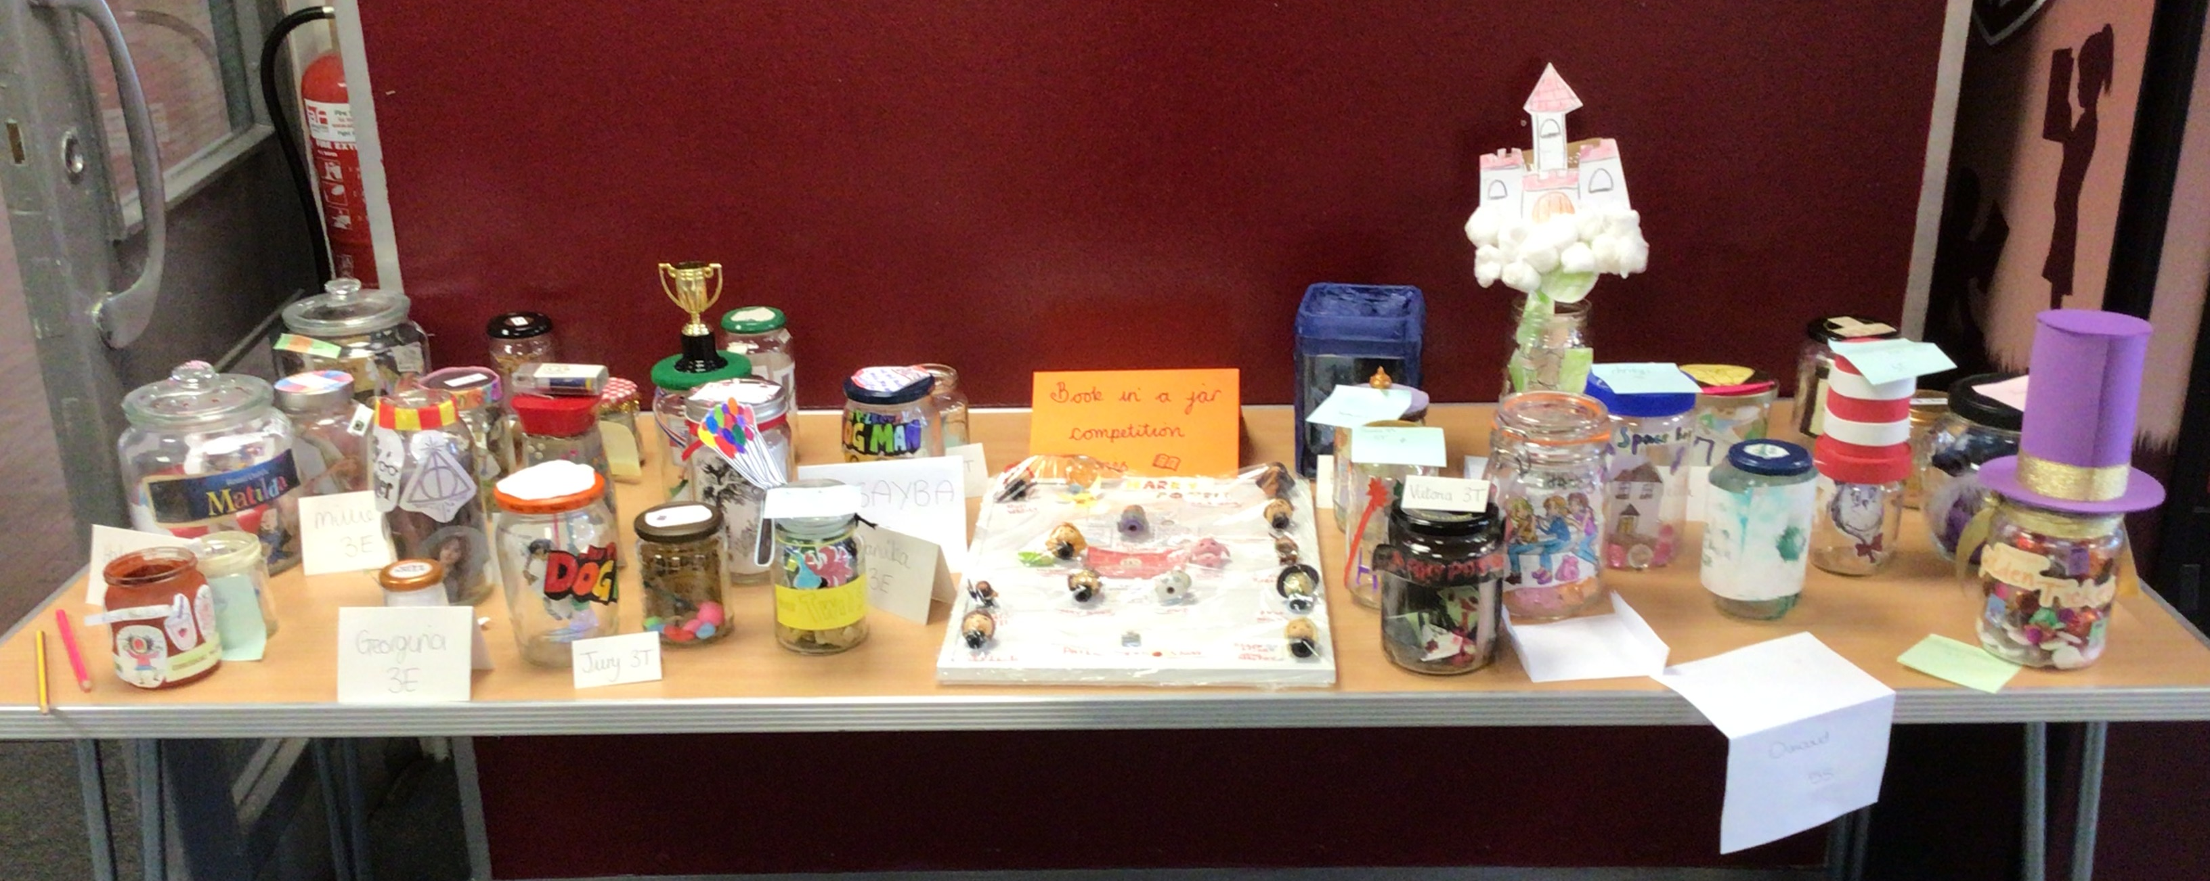
Reading events

Slide 7
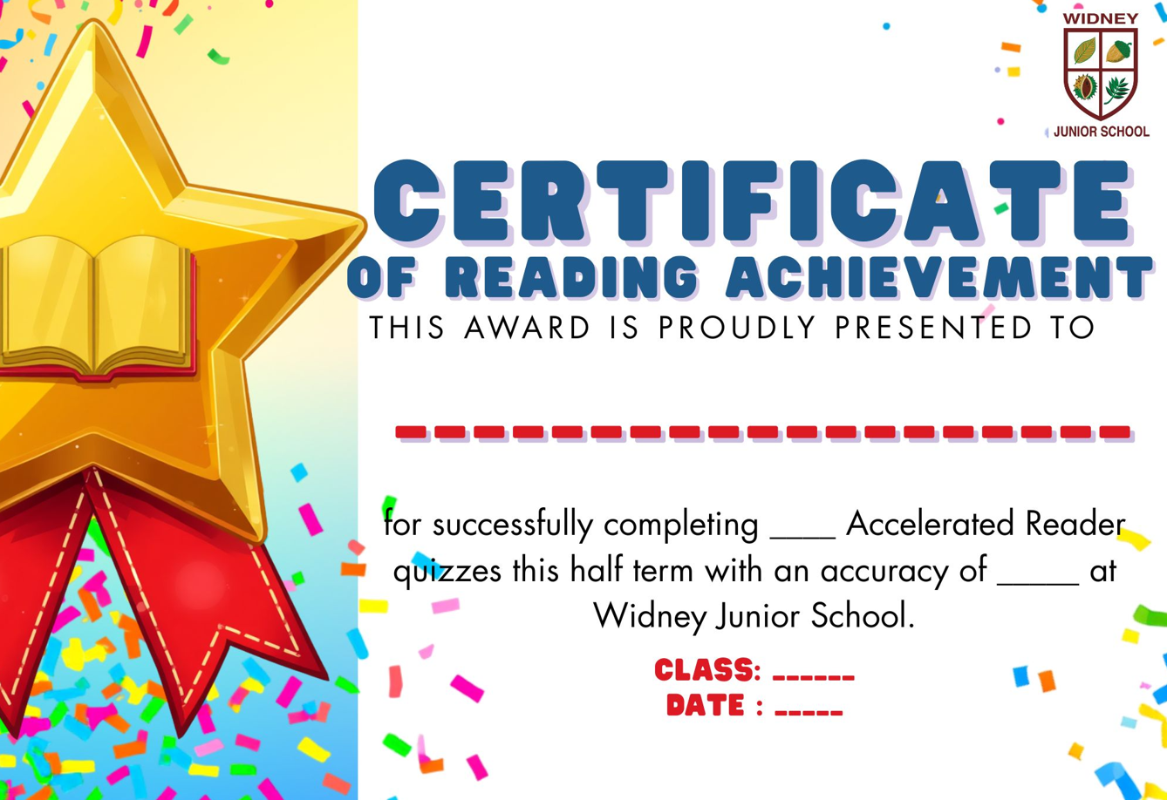
Celebration assemblies
Notes:
All fiction book are book banded.
Children take a star reader every half term and this tells us a rough reading age for the pupil and which colour books to read.
Children can also take quizzes on books they have read at school or at home. They must use a unique link which is stuck into their diary.
Children with higher book bands can read lower book bands too – consider age appropriate content (brilliant reader but you don’t want them to read content that’s too advanced.

Slide 8
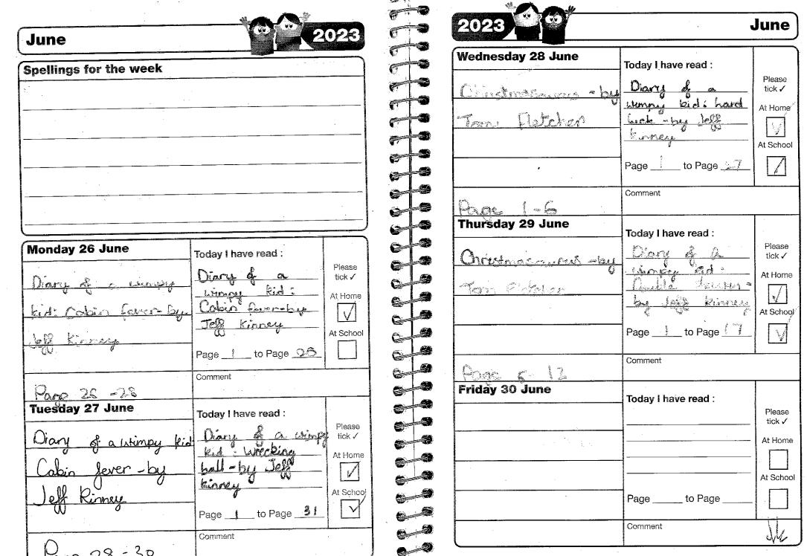
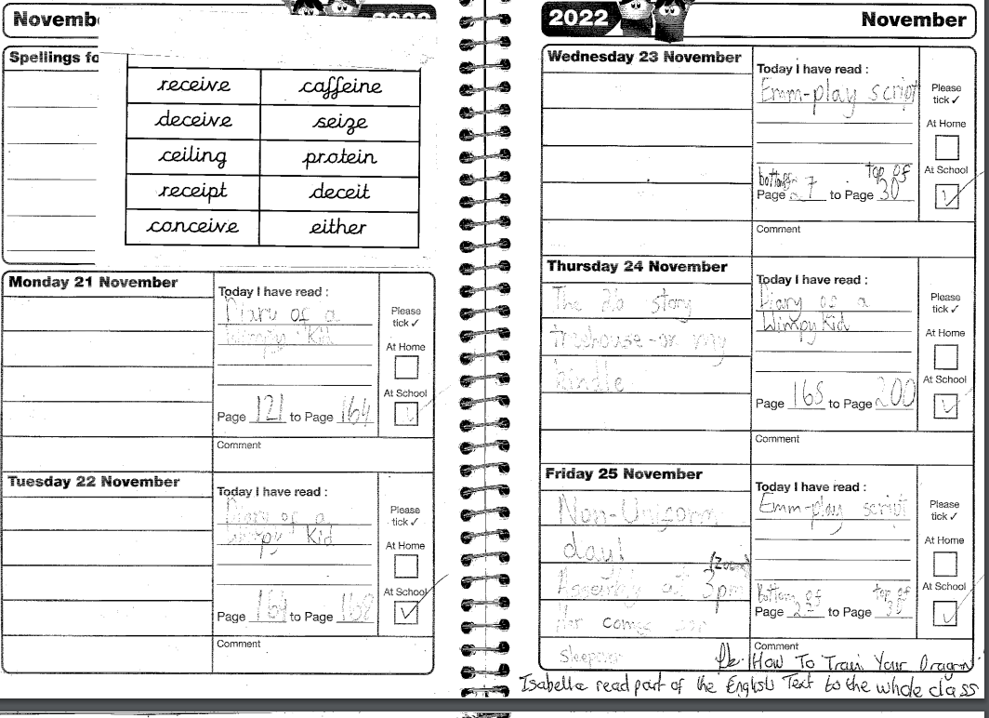
diaries

Slide 9
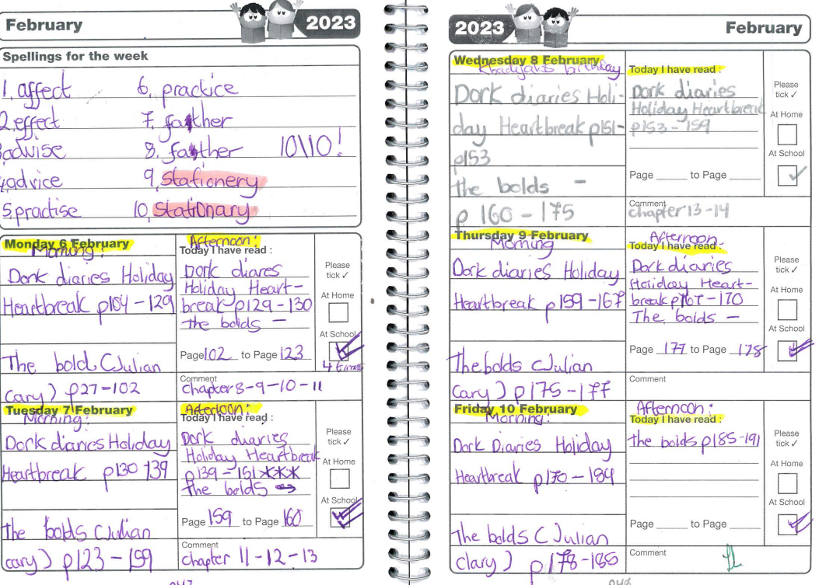
diaries

Slide 10
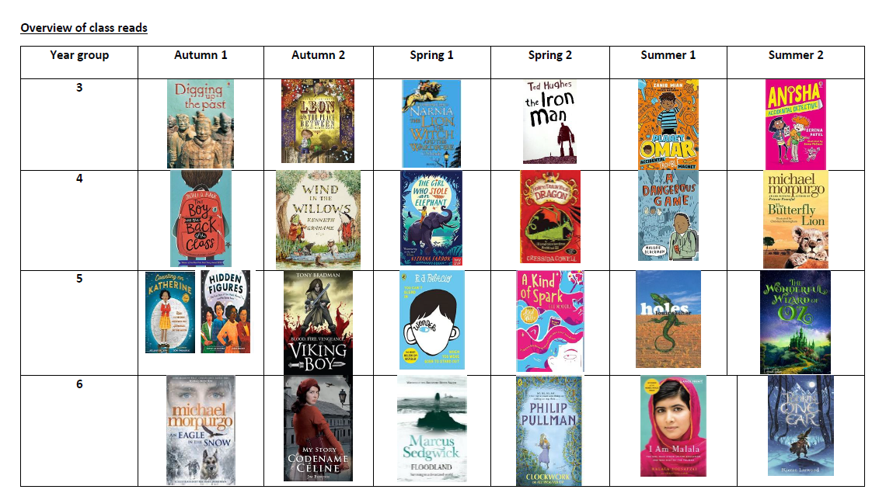
Class reads

Slide 11
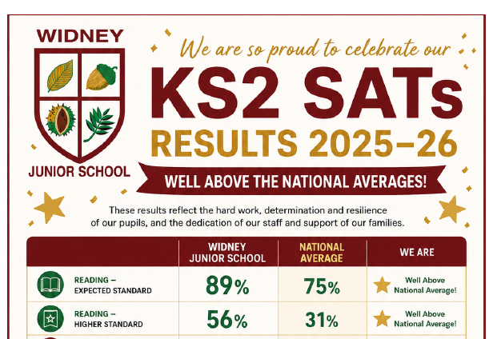
Our successes

Slide 12
Our successes
“I really like reading on the reading bus because it is quiet and it has lots of books to choose from.”
“I enjoy listening to my teacher when she reads at the end of the day.”
“I like book study lessons. Viking boy has been my favourite this year.”

Slide 13
Your child’s reading journey

Slide 14
Early Reading: Key Stage One
Children need to develop:
Pleasure in reading
Motivation to read
Increased vocabulary
Improved level of understanding
They will do this by frequently listening to:
Stories
Poems
Information texts
Texts they cannot read for themselves yet

Slide 15
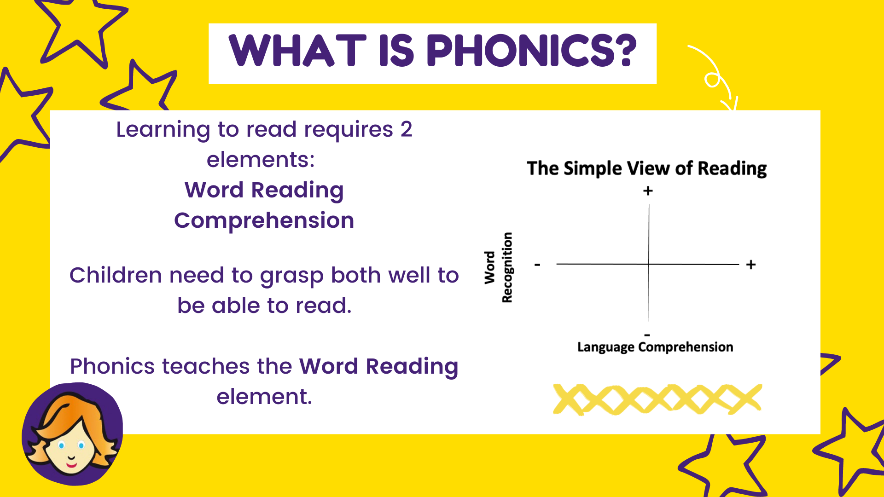
Phonics

Slide 16

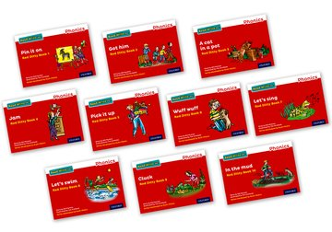
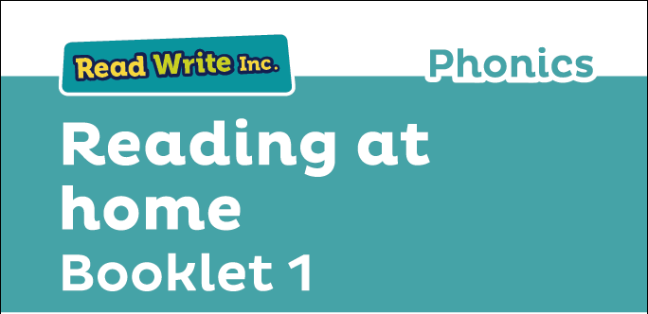
Phonics
Notes:
Successful Phonic programme –
It doesn’t matter if your child has learnt to read using a different programme. All approved phonic programmes teach children in a similar way.
31 children in Sept joined the programme – currently have 8 on the programme.
They take home a copy of the reading book and read it a few times. Research into how children learn, shows that repetition of words helps to store them to long term memory.
Each ½ term, children are assessed and are rewarded by certificates for trying hard or improving.
Booklets that can go home!

Slide 17
How you can help your child
Read with your child every day.
Model reading to your child with fluency and expression. Try to model reading unknown words.
Read a range of different texts, such as: recipe books, nursery rhymes, instruction manuals, leaflets for places you wish to visit and traditional tales.
Show your child how to find information in a book rather than quickly finding it for them.
To help your child apply their knowledge of sounds to spellings, ask them to write your weekly shopping list.

Slide 18
How you can help your child
Pretend that you are unable to read particular words and ask your child to read them to you, encouraging them to segment words into their sound parts and blend them to read the whole word.
Ask your child what they predict the story could be about by looking at the title and front cover. Then, later in the text, ask your child what could happen next.
Discuss the setting of the story. Have you read another book with a similar setting?
Discuss alternate words, e.g. ‘Which word could the author have used that’s more exciting than big?’

Slide 19
KS2 expectations
By the time children leave year 6, they are expected to:
Increase their familiarity with a wide range of books, including myths, legends and fiction from our literacy heritage.
Recommend books to their peers.
Identify themes across a wide range of texts.
Make comparisons within and across books.
Understand and explain the meaning of words in context.
Draw inferences from a text and justify these with evidence.
Summarise the main ideas from more than one paragraph.

Slide 20
KS2 expectations
By the time children leave year 6, they are expected to:
Use stated or implied details to make predictions about what may happen next.
Retrieve, record and present information from a non-fiction text.
Distinguish between statements of fact and opinion.
Discuss and evaluate the author’s choice of language.
Provide reasoned justifications for their views.

Slide 21
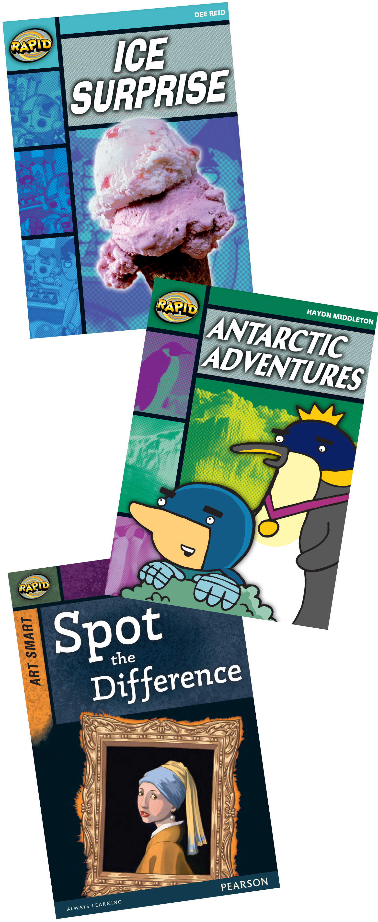

Rapid Reading
Rapid Reading is the catch-up route to success for struggling readers to help with fluency and comprehension.

Slide 22

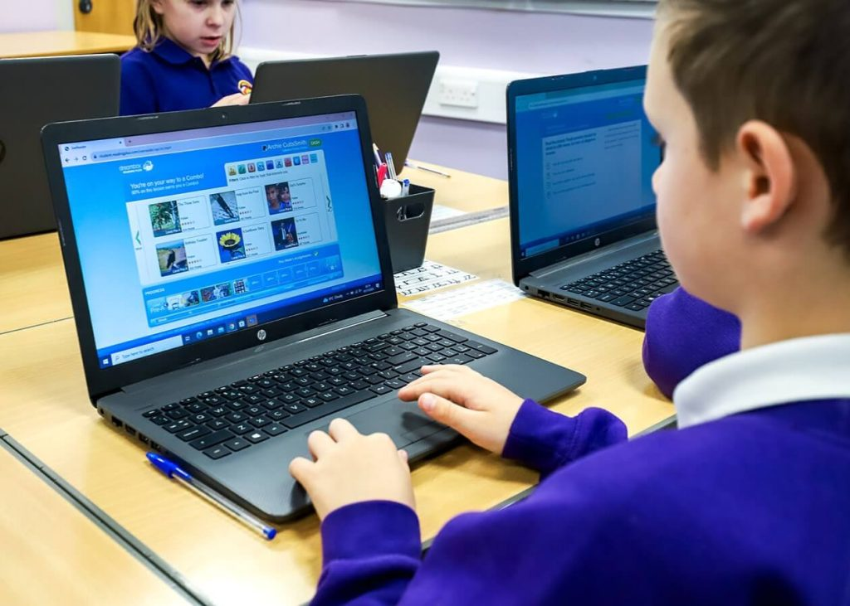
Reading plus
Reading Plus is an online reading development programme used by our school to support pupils in becoming confident, fluent and independent readers. It is designed to improve comprehension, reading speed and vocabulary through personalised learning.
Notes:
The programme begins with an assessment that identifies each child’s current reading ability. Based on this, Reading Plus creates an individual pathway, ensuring that every pupil works at a level that is appropriate for them while still providing the right level of challenge.

Slide 23


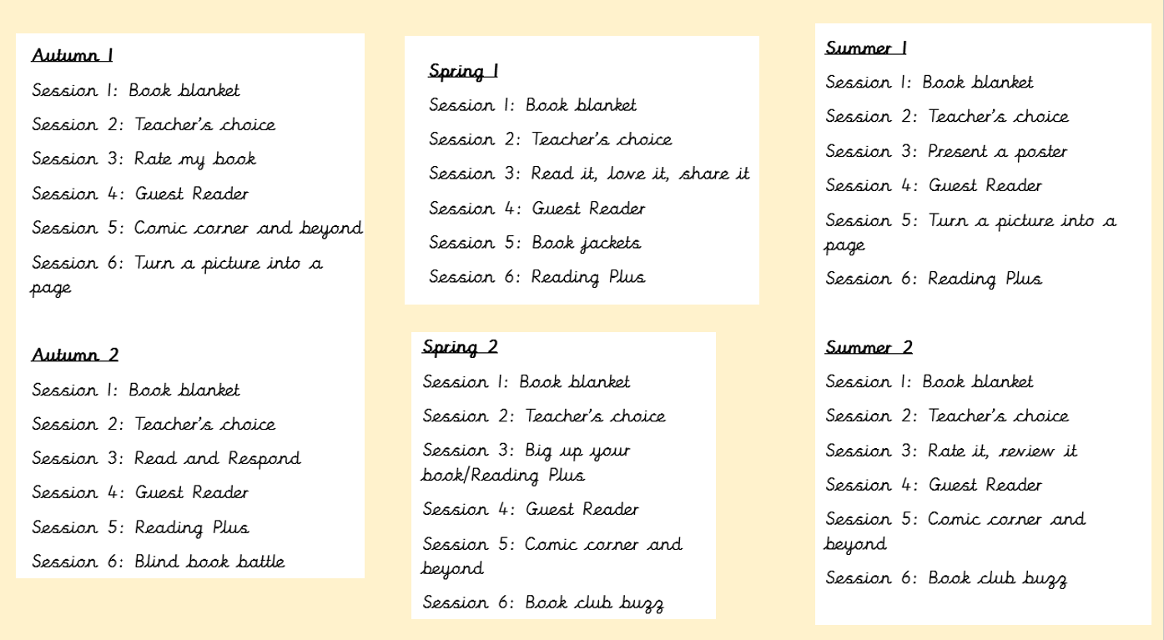
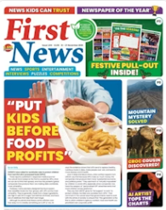
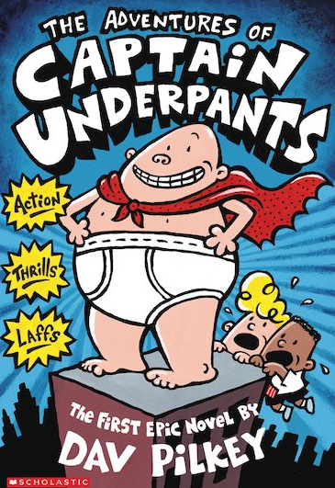
Book Club

Slide 24
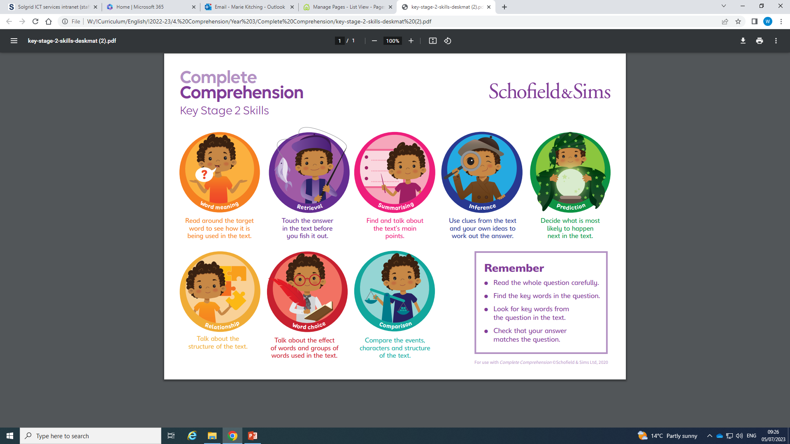
Reading comprehension
Notes:
Also mention book talk where we help children to craft their answers and the teacher supports the children by modelling answers.

Slide 25
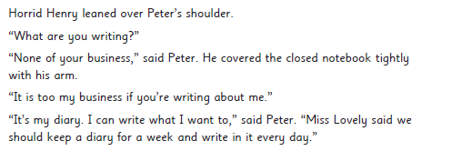

Prediction
An extract taken from
Horrid Henry and the Football Fiend, by Francesca Simon
…
Notes:
Year 2 comprehension
In this extract, Horrid Henry and his brother Perfect Peter have a fight about Peter’s diary.

Slide 26
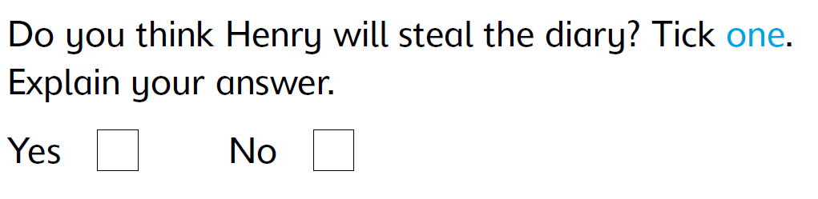
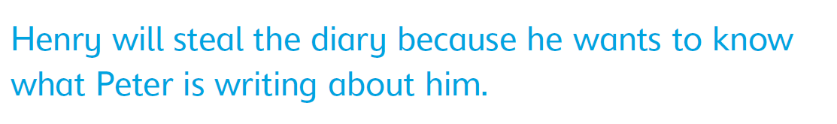
Prediction
Answer: Yes

Slide 27
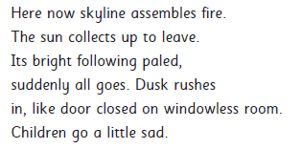
Word meaning
Extract taken from ‘Night Comes Too Soon’ by James Berry
Question: Look at the first verse.
Find and copy one word that means the light is fading?
Answer: paled / dusk
Notes:
Year 3 Word meaning
In this poem the poet is thinking back to when he was a child and remembering how he felt towards the end of the day as night falls.
Answer: paled / dusk

Slide 28
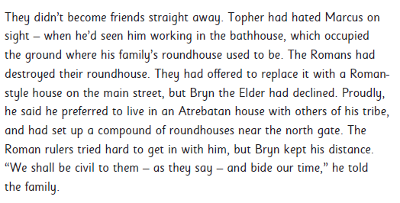
Retrieval
An extract taken from ‘The Time-Travelling Cat and the Roman Eagle,’ by Julia Jarman
Notes:
Taken from a Year 4 comprehension.
This text is set in Roman Britain in 79 CE. It focuses on Topher, a child, and his father, Bryn the Elder, who is leader of the Atrebates tribe. In this extract, Topher becomes friends with Marcus, a Roman mosaic-maker and becomes apprentice to Marcus’ father, Cassius.

Slide 29
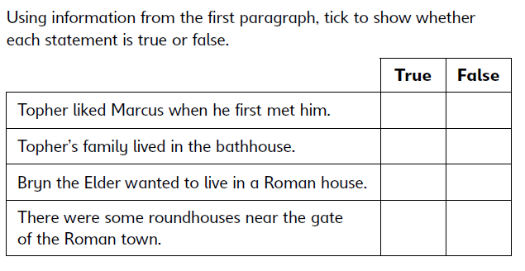
Retrieval
An extract taken from ‘The Time-Travelling Cat and the Roman Eagle,’ by Julia Jarman
Notes:
Taken from a Year 4 comprehension.
This text is set in Roman Britain in 79 CE. It focuses on Topher, a child, and his father, Bryn the Elder, who is leader of the Atrebates tribe. In this extract, Topher becomes friends with Marcus, a Roman mosaic-maker and becomes apprentice to Marcus’ father, Cassius.

Slide 30
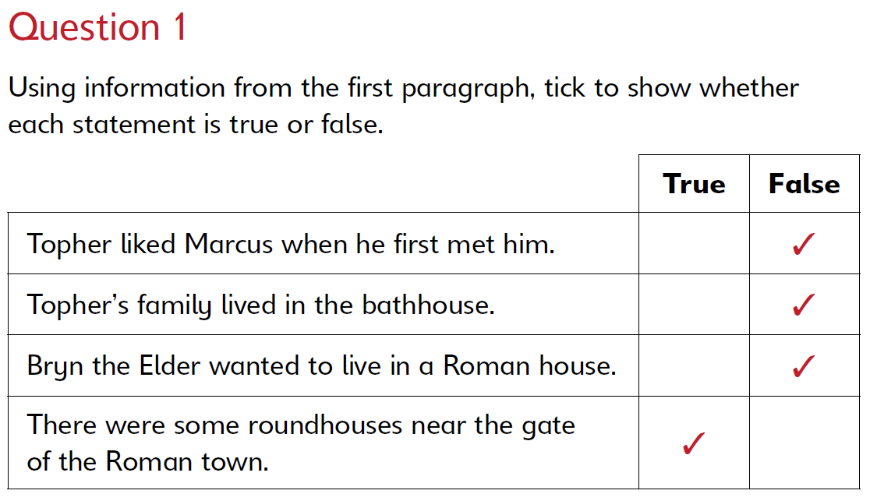
Retrieval
An extract taken from ‘The Time-Travelling Cat and the Roman Eagle,’ by Julia Jarman
Notes:
Taken from a Year 4 comprehension.
This text is set in Roman Britain in 79 CE. It focuses on Topher, a child, and his father, Bryn the Elder, who is leader of the Atrebates tribe. In this extract, Topher becomes friends with Marcus, a Roman mosaic-maker and becomes apprentice to Marcus’ father, Cassius.

Slide 31

Summarising
An extract taken from Life in Tudor Britain, by Anita Ganeri
Question: Look at the paragraph beginning Towards the end of Tudor times…
What is the main point of this paragraph?
Answer: Tudor people started to eat new foods from around the world.
Notes:
Taken from a Year 5 comprehension
The Tudors reigned in England from 1485 to 1603. Back then, life was very different. This text tells us about some of the things that were different.

Slide 32
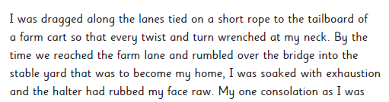
Inference
An extract from War Horse, by Michael Morpurgo
Question: Look at the first two sentences.
How do you think Joey feels at this point in the story? Explain your answer using evidence from the text.
Answer: Terrified/In pain because he’s being hurt all the way to the farm.
Notes:
Taken from year 6 comprehension
This famous book tells the story of Joey, a young horse who is sent to work on the battlefields during World War I. In this extract, Joey arrives at a new home after being bought at a market. He overhears a conversation between a boy and his mother.

Slide 33
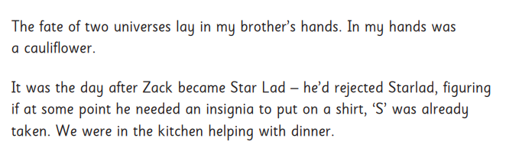
Relationship
An extract from ‘My Brother Is a Superhero’ by David Solomons
Question: Explain why the opening sentences are humorous.
Answer: The items the brothers are holding are so different, one is really important and one is just a vegetable.
Notes:
Year 3 comprehension
In this text, Luke can’t believe that his brother, Zack, has been given a superpower instead of him. Luke tries to guide Zack to understand how superheroes should behave.

Slide 34
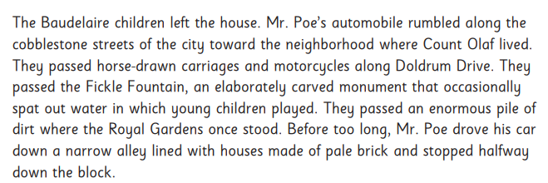
Word choice
Extract from ‘A Series of Unfortunate Events: The Bad Beginning’ by Lemony Snicket
Notes:
Year 4 comprehension
In this extract, Mr Poe takes the Baudelaire orphans to their new home where they will live with their new guardian, Count Olaf. The author builds tension and creates a dark atmosphere through his choice of words and use of contrast.

Slide 35
Word choice
Extract from ‘A Series of Unfortunate Events: The Bad Beginning’ by Lemony Snicket
Question: Mr Poe’s automobile rumbled along the cobblestone streets of the city … . The author uses the word automobile instead of ‘car’. What effect does this have?
Answers: It makes it feel formal/‘posh’. OR It feels old fashioned/ not modern. OR It feels like a different time. OR It makes it feel foreign.
Notes:
Year 4 comprehension
In this extract, Mr Poe takes the Baudelaire orphans to their new home where they will live with their new guardian, Count Olaf. The author builds tension and creates a dark atmosphere through his choice of words and use of contrast.

Slide 36
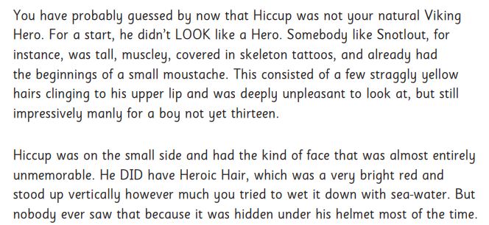
Comparison
An extract from ‘How to Train Your Dragon’ by Cressida Cowell
Notes:
Year 5 comprehension
This is an extract from a story about a Viking boy called Hiccup who needs to capture and train a dragon in order to live on the island of Berk. At this point in the story, Hiccup is about to start his challenge with other boys from the island

Slide 37
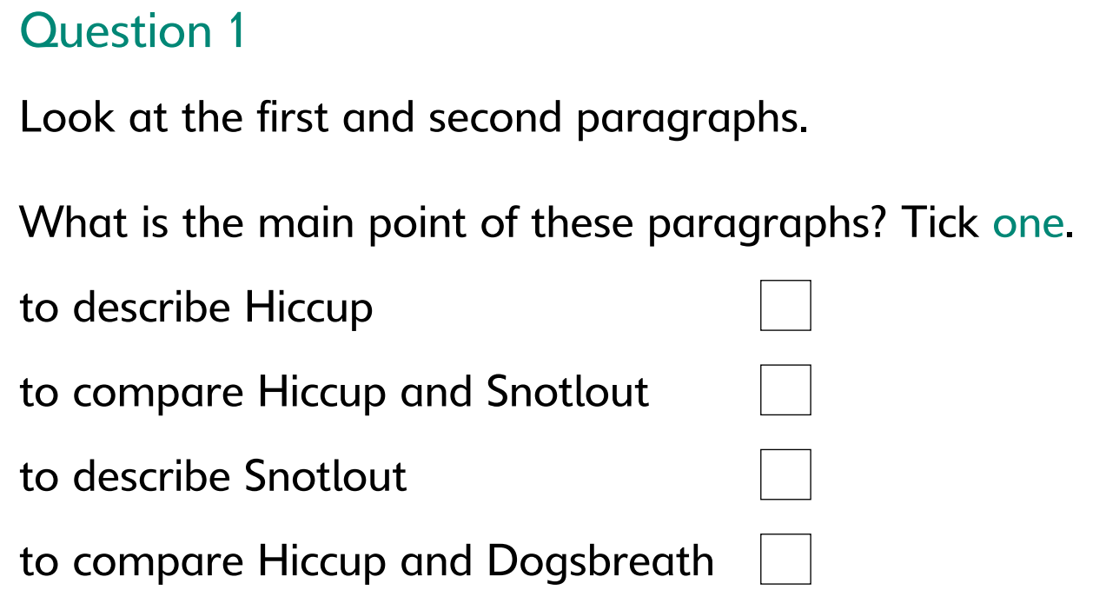
Comparison
An extract from ‘How to Train Your Dragon’ by Cressida Cowell
✓

Slide 38
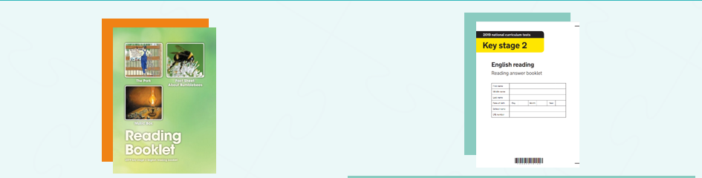
Year 6 SATs
Each year in May, year 6 children take part in a SATs reading paper. The paper is designed to test children’s reading and comprehension skills across all areas of the curriculum.
Notes:
The reading test is made up of 2 parts: a reading booklet which contains 3 texts of increasing difficulty.
An answer booklet which contains a variety of questions about each of the texts, each relating to one of the areas stated in the NC. The 8 areas of comprehension we cover, targets all these areas of the NC.
The children have 1 hour to complete the whole paper and they are expected to read it themselves with no help given.

Slide 39
How you can help your child
Read with your child or let them read independently every day.
See the question handout sheet to take home.
You can still ask questions about your child’s book even if they prefer to read on their own. Try asking them to summarise what they have just read or if they have discovered new words.
Have a variety of reading materials available, such as newspapers, reference books, fiction and non-fiction books.
Show that you enjoy reading by sharing things that you have discovered.

Slide 40
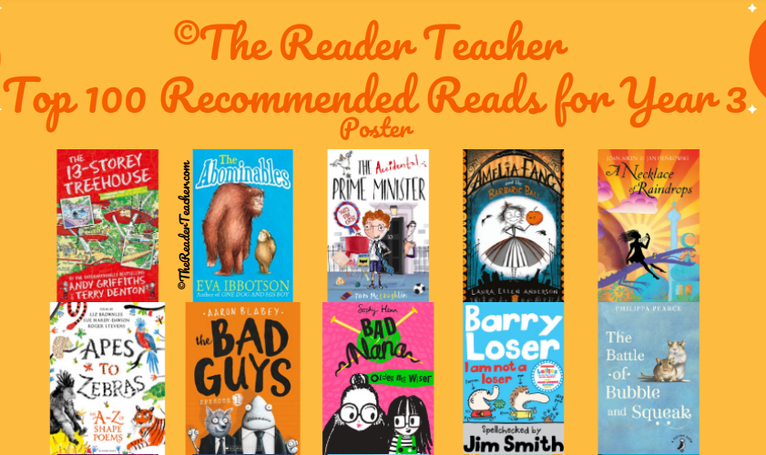
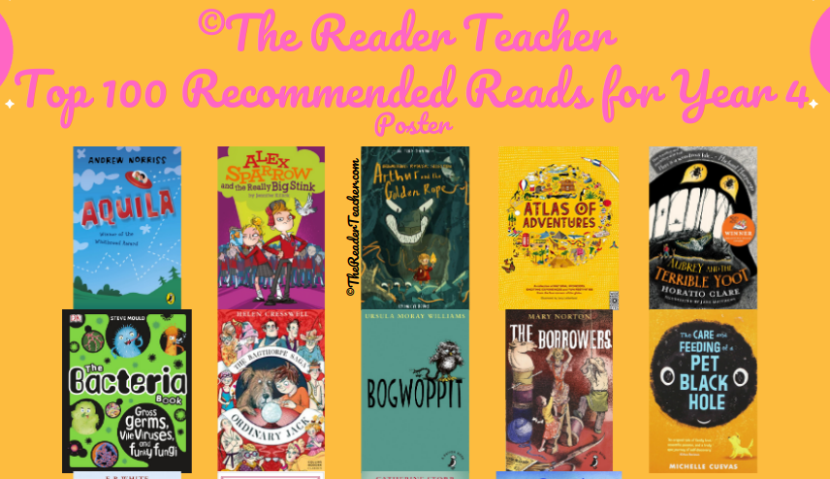
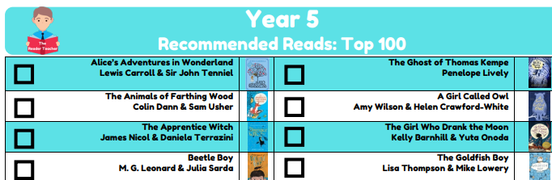
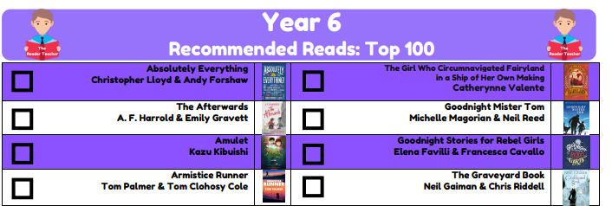
Suggested reads

Slide 41
English
Handwriting (Kinetic Letters) ~ Daily
Spellings ~ Daily
Grammar and Punctuation ~ Weekly
Writing ~ Daily

Slide 42
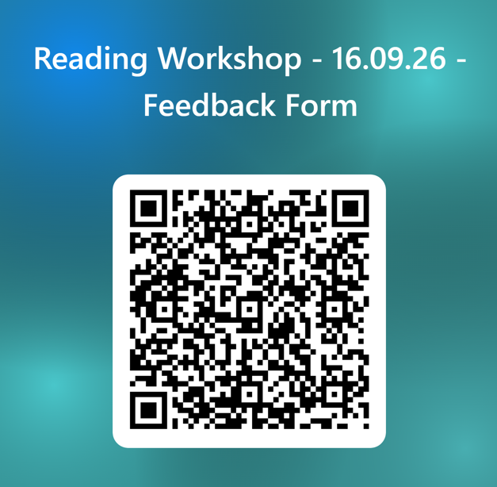
Questions?

